Slide 1



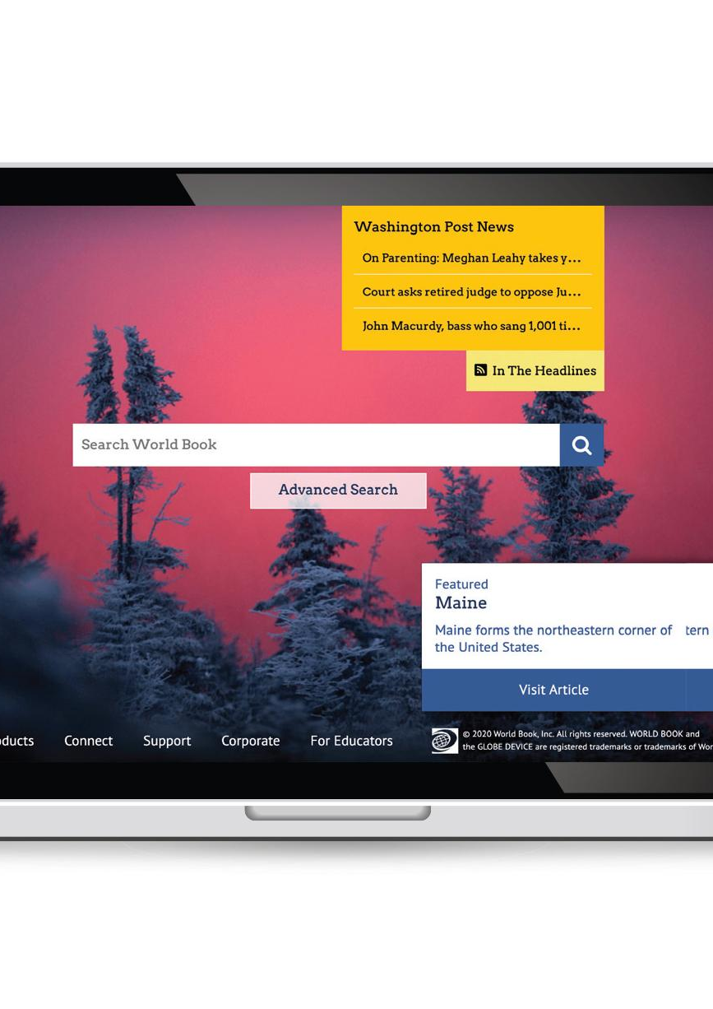



World Book
Advanced
Research • Teaching • Academic Success
Notes:
These slides were provided by and created by World Book. INFOhio added a few directional slides to help users know how to get to the resources and how to learn more through the Learning Pathways Classes.

Slide 2
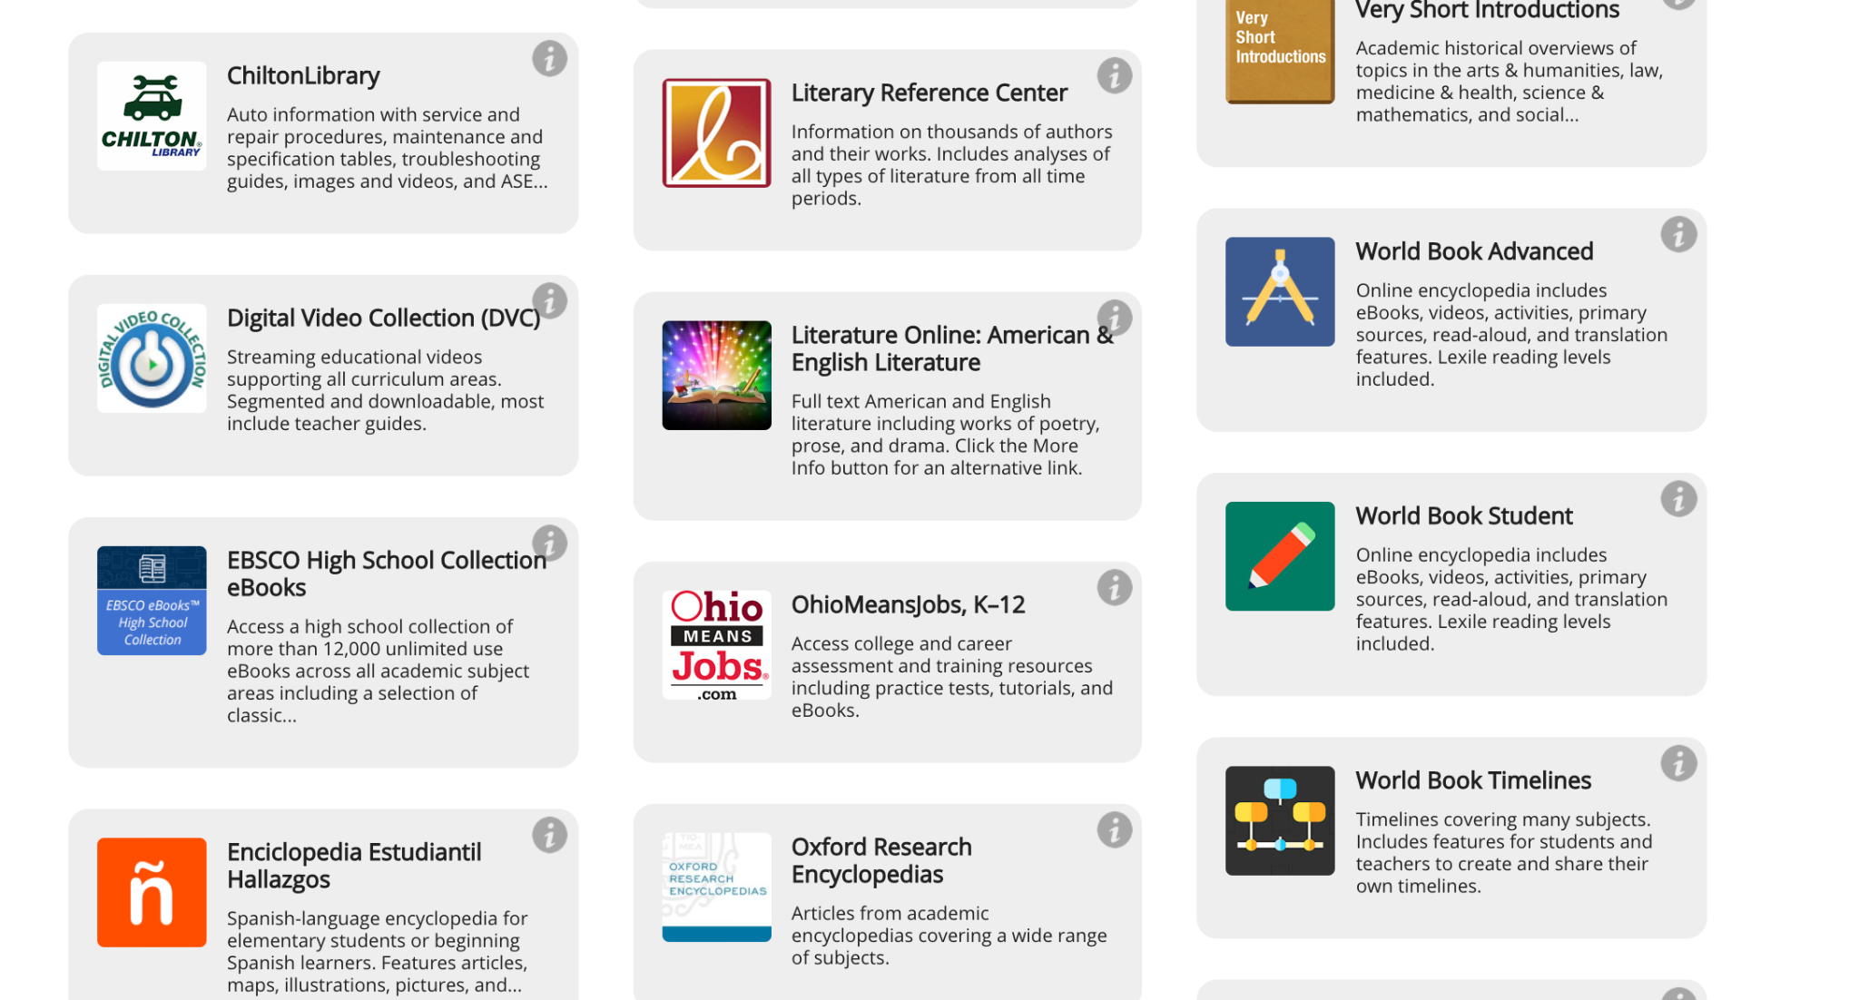
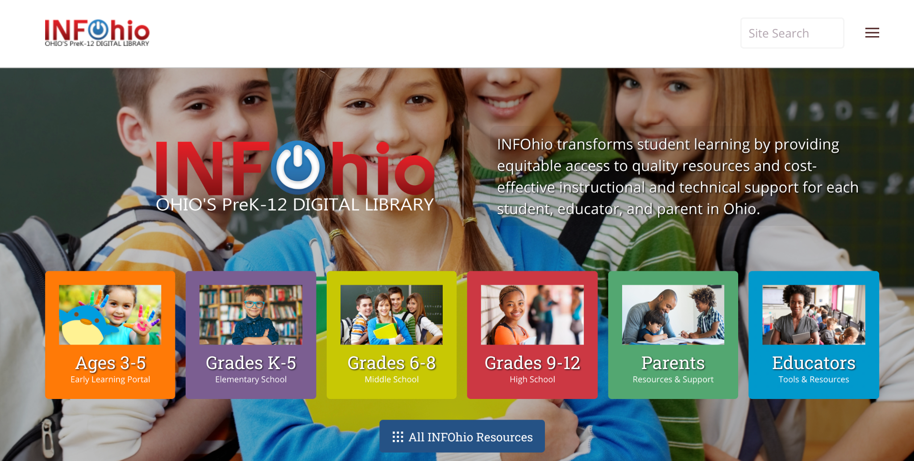
Notes:
*This slide has animation. Use Present mode to view.*
To find the World Book Advanced resource on the INFOhio website go to the INFOhio homepage: https://www.infohio.org. Click the Grades 9-12 button. <click> The i button will give further training and support for the resource, or click anywhere on the resource box to open the resource.

Slide 3
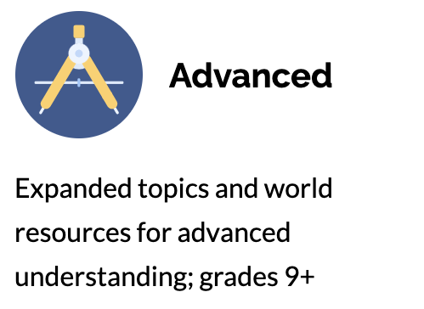
Advanced
Organize research with tools like My Research and Pathfinders
Create easy bibliographies and cite sources using the free citation builder
Build global awareness and stay up-to-date with In the Headlines, World Newspapers, and Behind the Headlines
Dig deeper with primary source documents and special reports
Find Pathfinders of pre-generated content sets aid in research and subject matter understanding
Notes:
For more information/talking points, check here- https://www.worldbookonline.com/training/products/advanced/advanced-index.htm

Slide 4
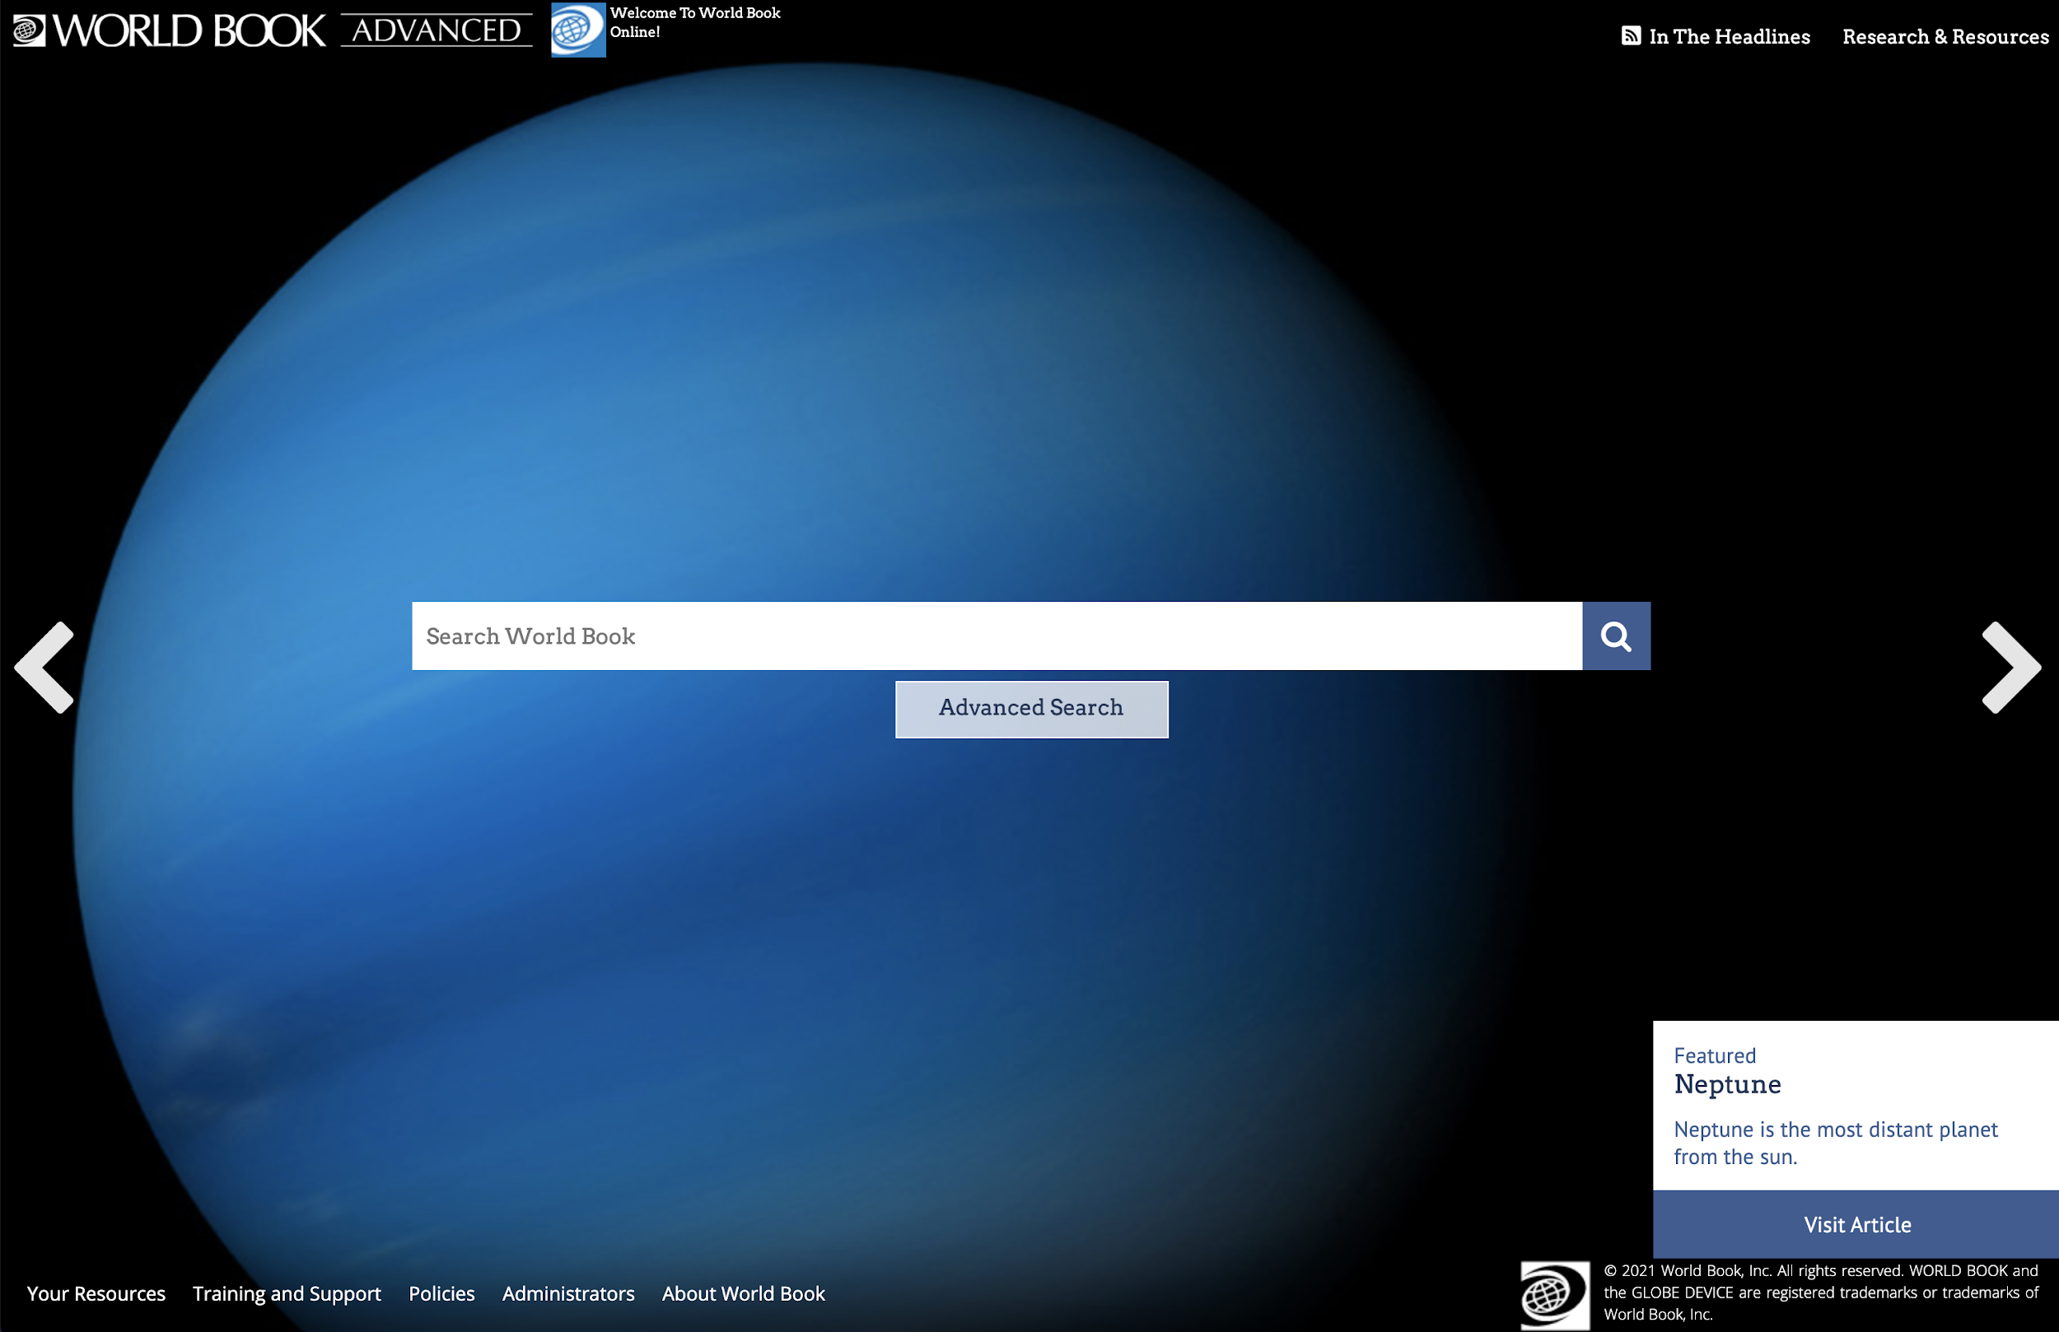
Features

Slide 5
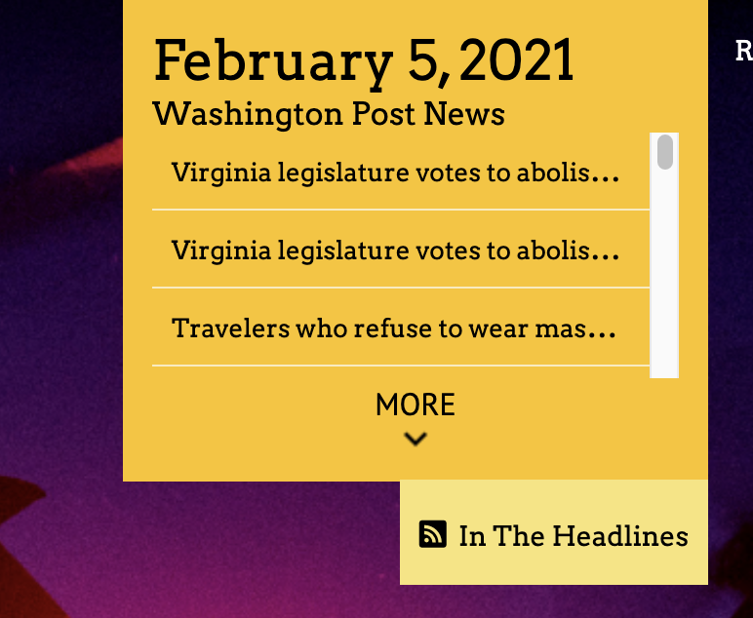
In the Headlines
Stay in-the-know with In the Headlines, a live news feed that contains up-to-the-minute breaking news.
Accounts can select from 8 different RSS feeds to display.

Slide 6
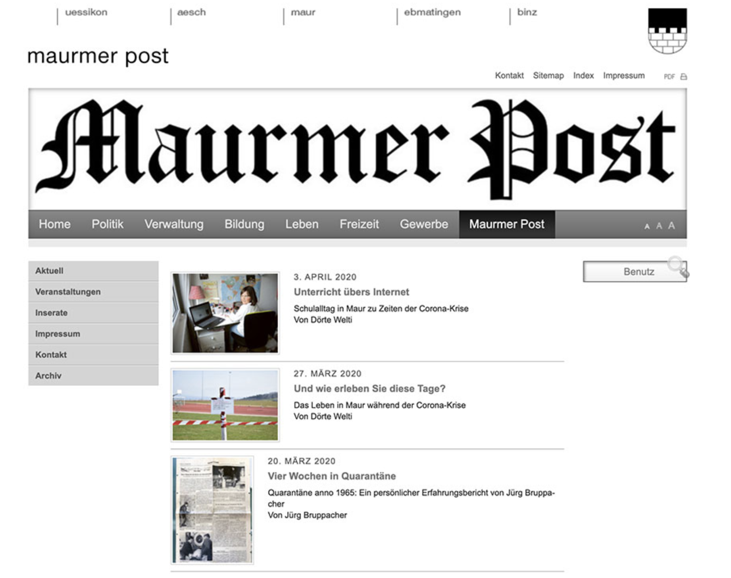
Build global awareness
Access links to 400+ newspapers from throughout the U.S. and around the world with World Newspapers. Take a look at how we are reporting on the same topic as other countries to compare and build perspective.
Patrons can read news from other countries in other languages.

Slide 7
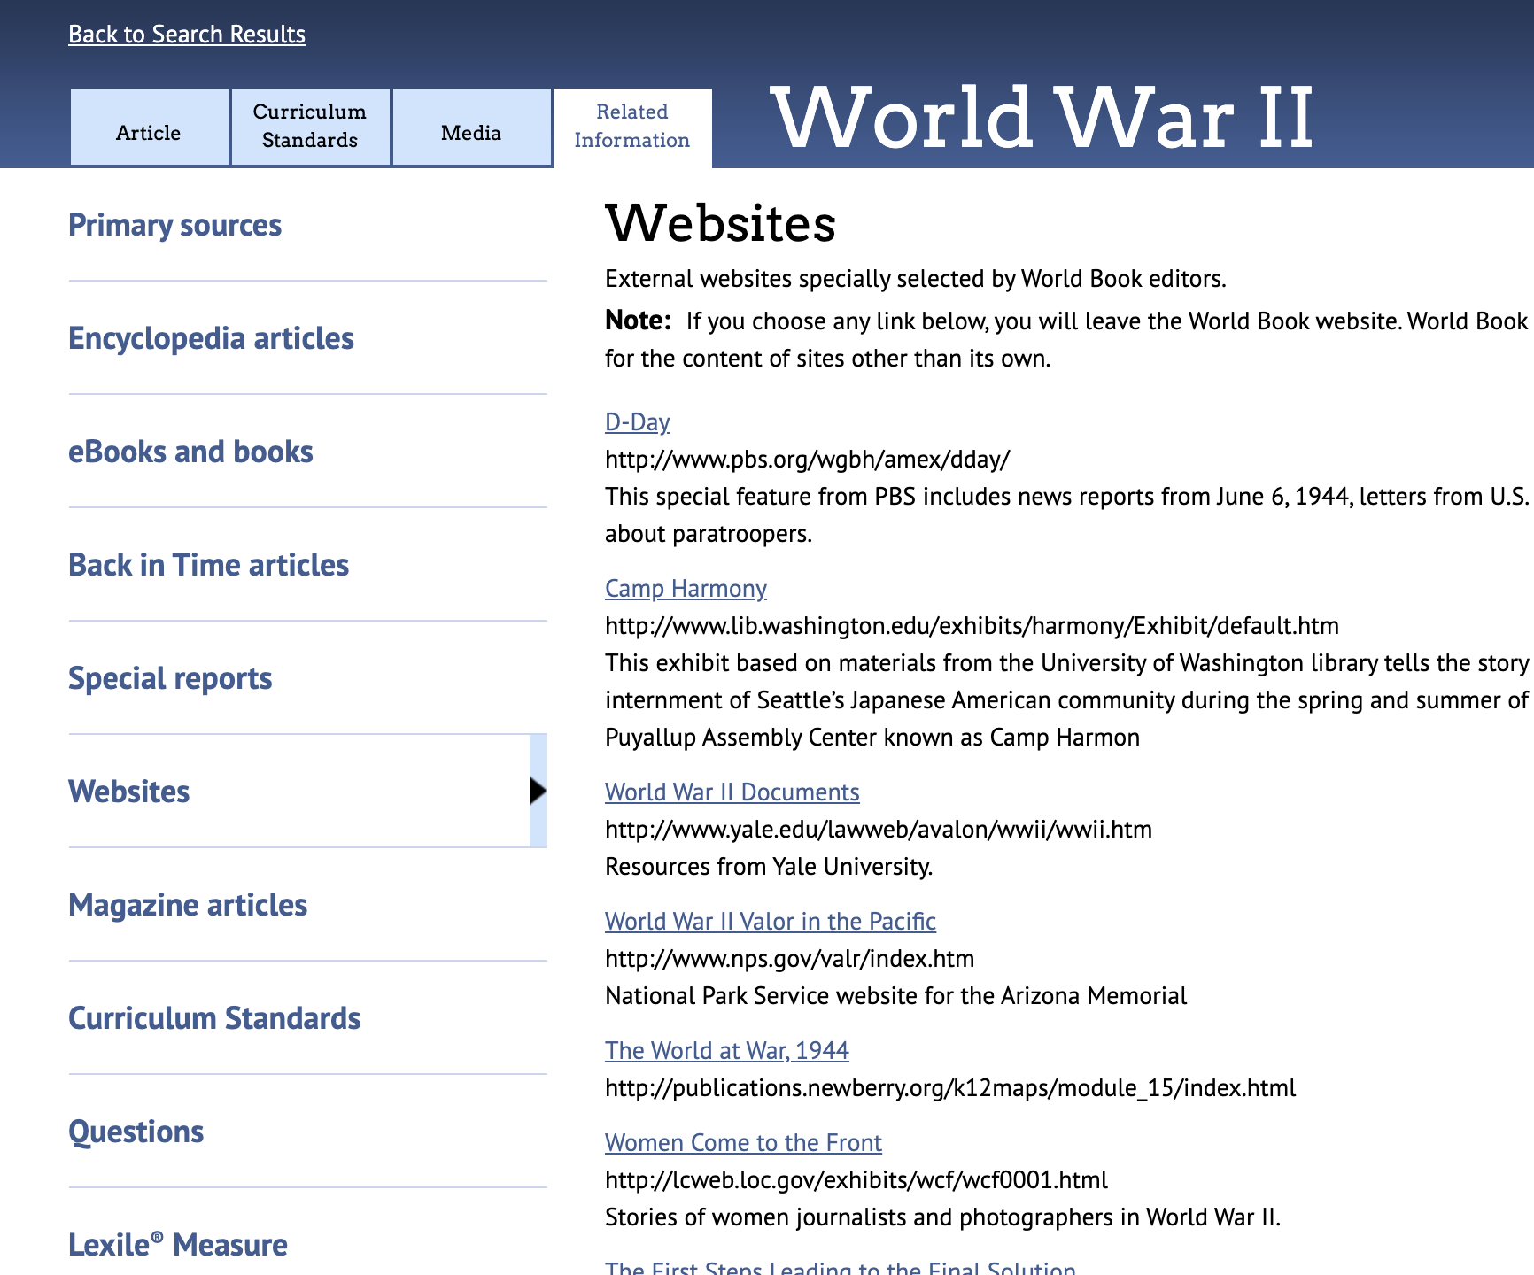
Deepen research with Advanced sources
Take research to the next level with advanced source types found under Related Information
Primary source documents
Websites specially selected by World Book editors
Popular and scholarly articles through our partnership with EBSCO
eBook titles
Special reports

Slide 8
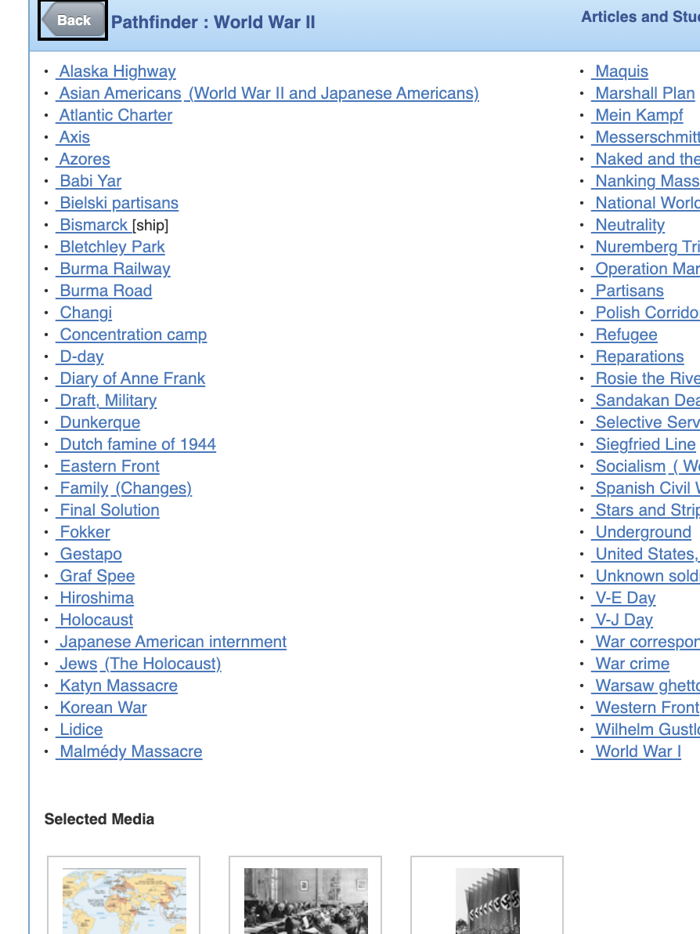
Pathfinders
Pathfinders are collections of resources on a specific topic. This collection can include encyclopedia articles, primary source documents, timelines, multimedia, and more.
Use these as article and study aids.
Share them with students to help guide research or share information on a topic.
Teachers can also create their own from scratch to share with students or in the district!

Slide 9
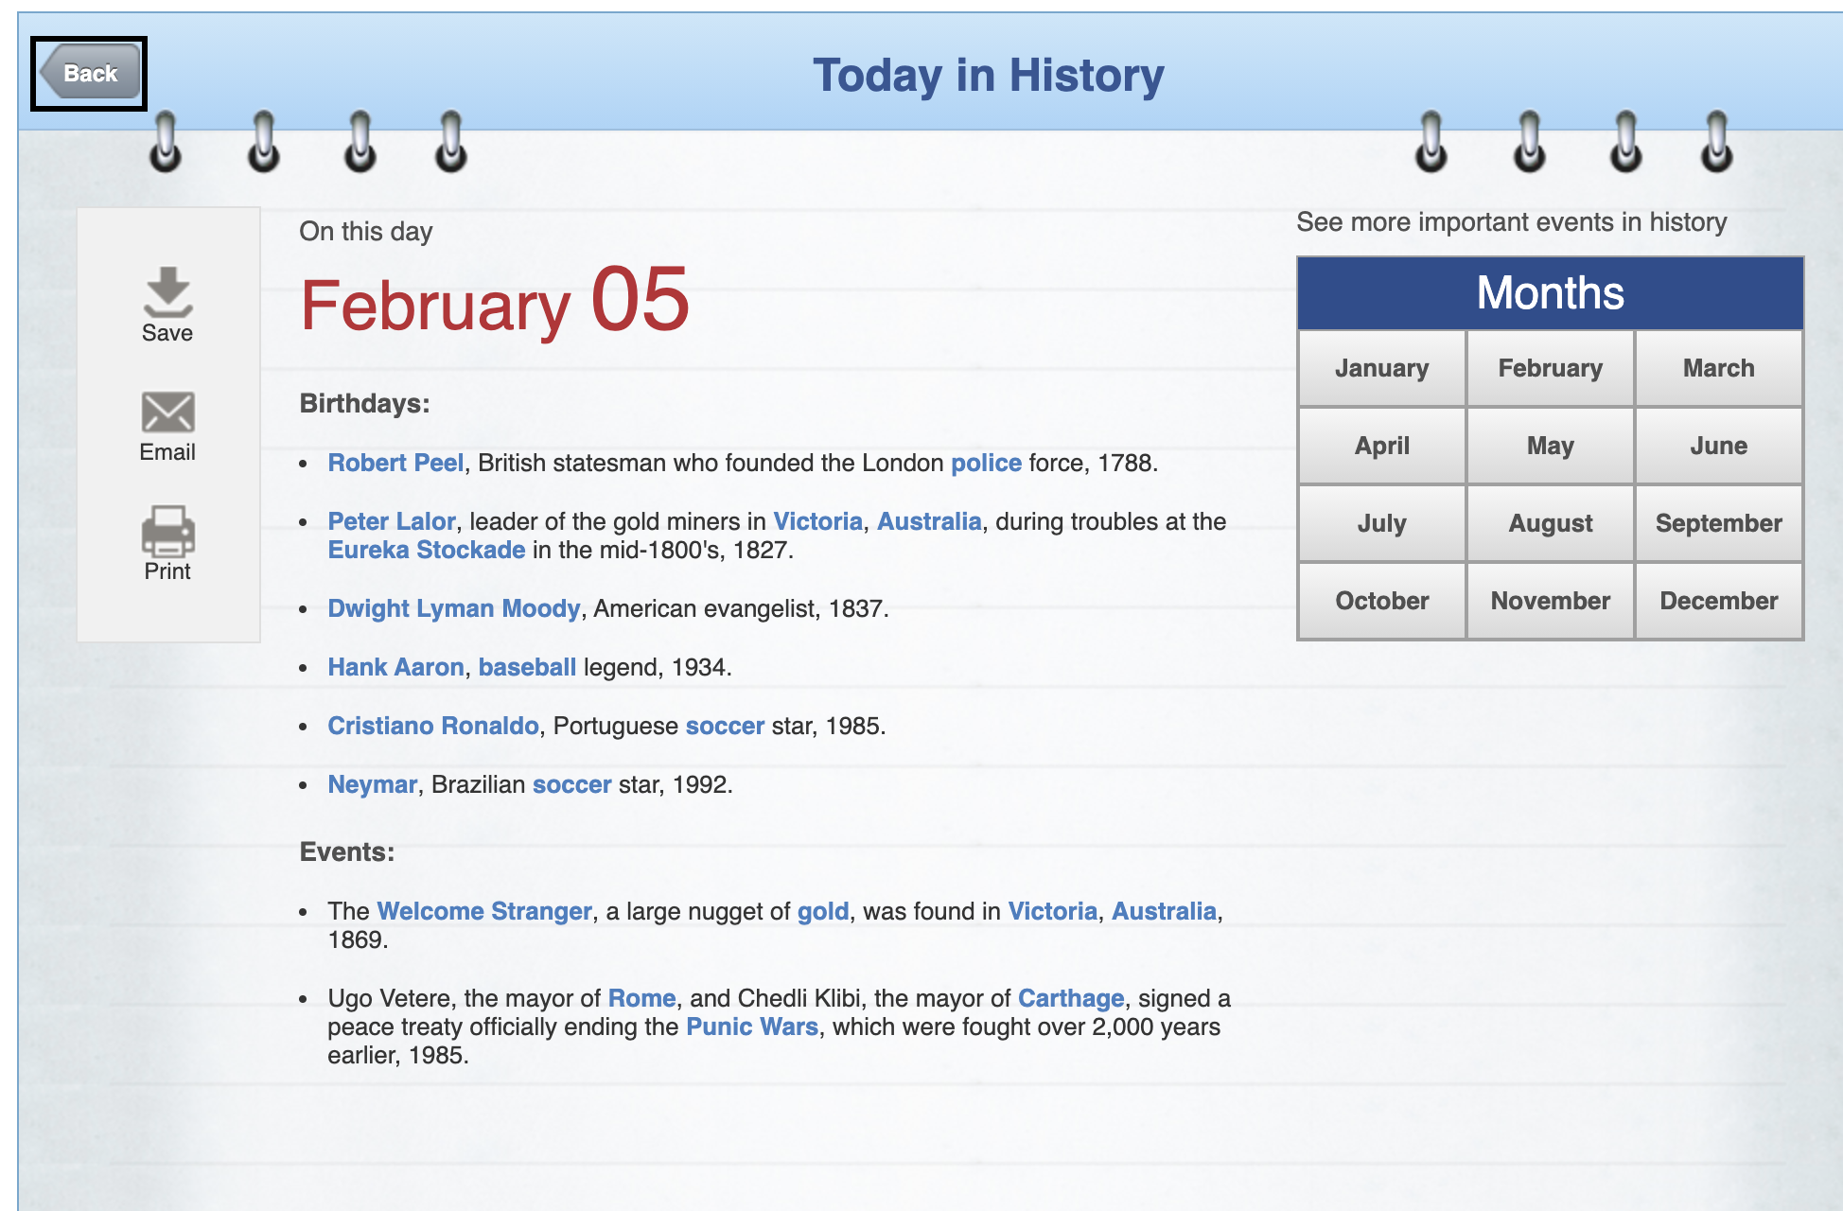
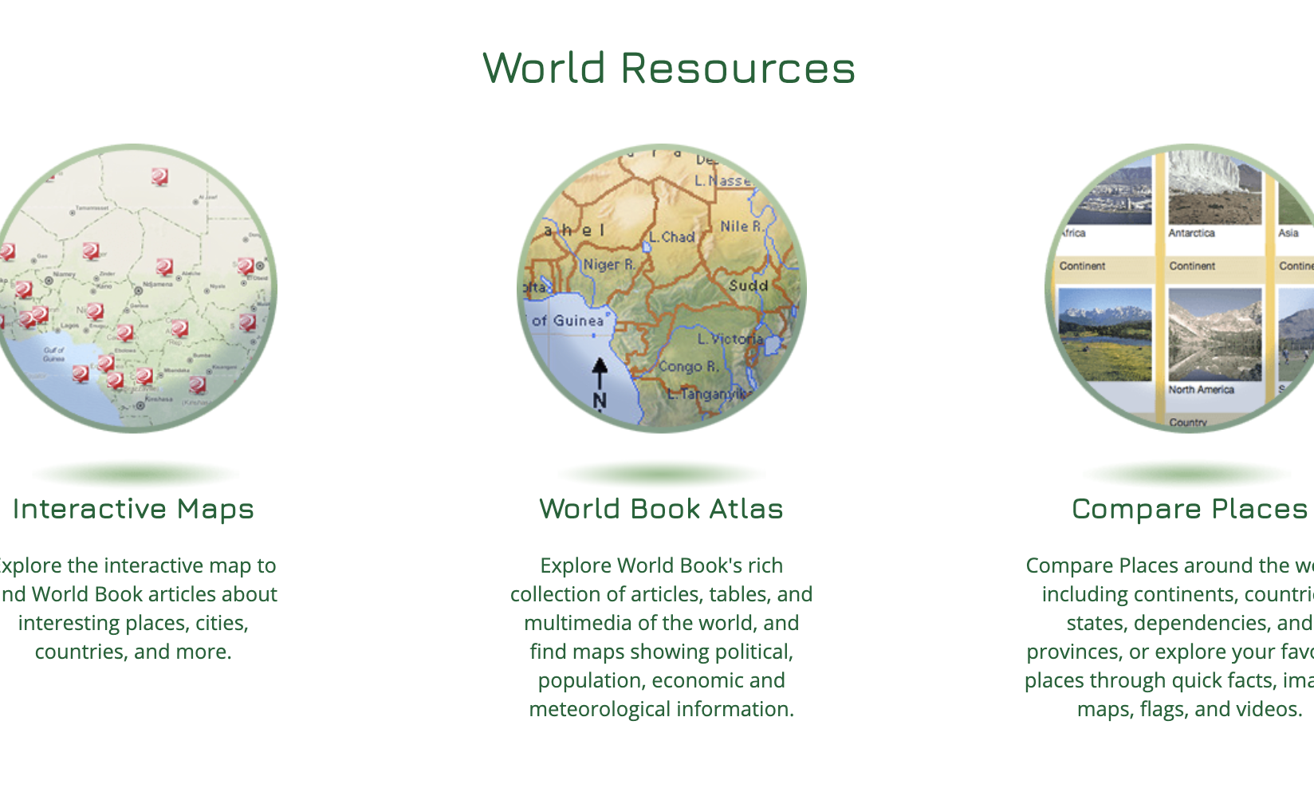
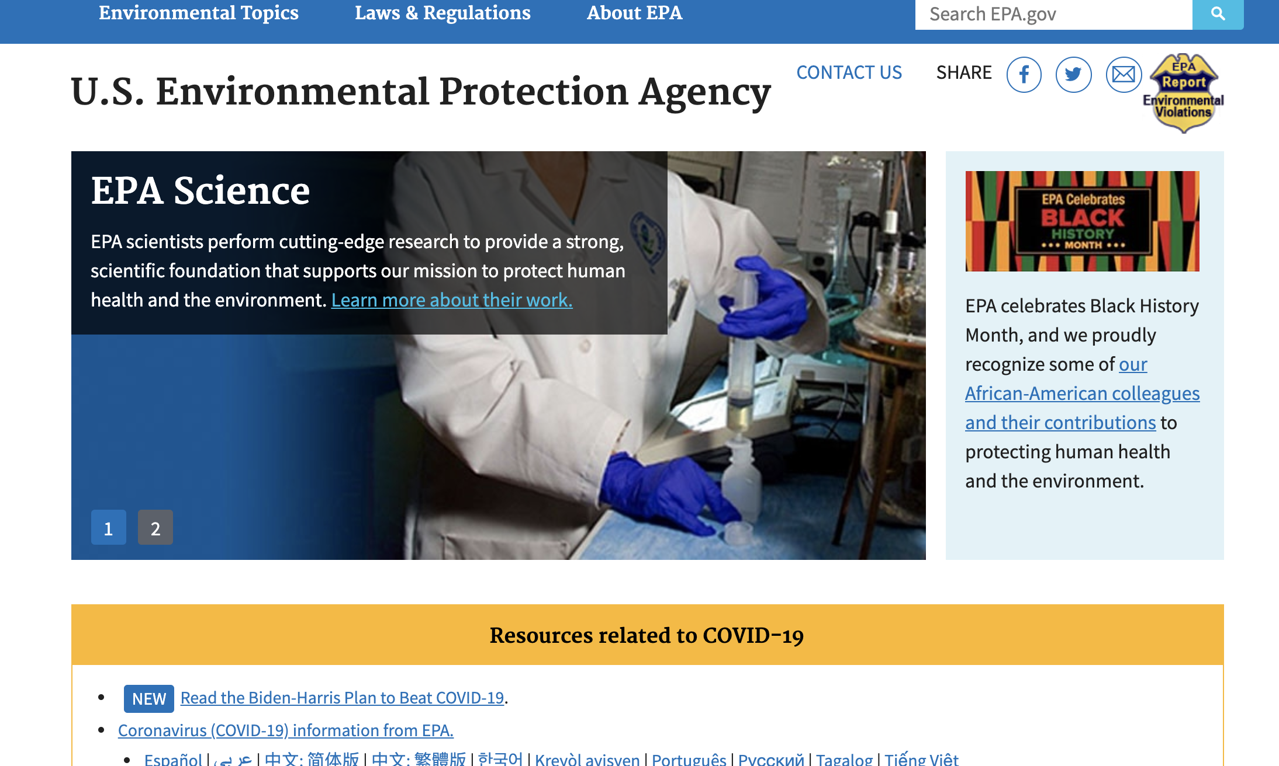
Additional Features
Use the Today in History feature as a bell ringer activity.
Take a deeper dive through the World Resources features. From interactive maps to a virtual atlas – students can view maps & information in a variety of formats.
Access links to government websites quickly for additional sources for research.

Slide 10
Tools to elevate learning

Slide 11
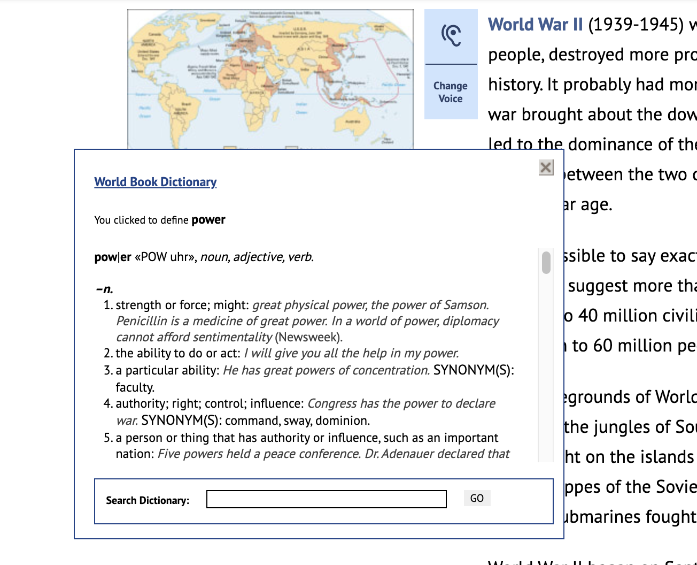
Articles include features to guide learners
The built-in read-aloud function includes a word-by-word highlight while reading to help with pronunciation and understanding new words in context.
Double click any word for a pop-out dictionary definition.
Every article can be translated into over 100 languages.
The media tab offers pictures, videos, and games on some articles.
The Related tab holds links to related articles, sources, and more.

Slide 12
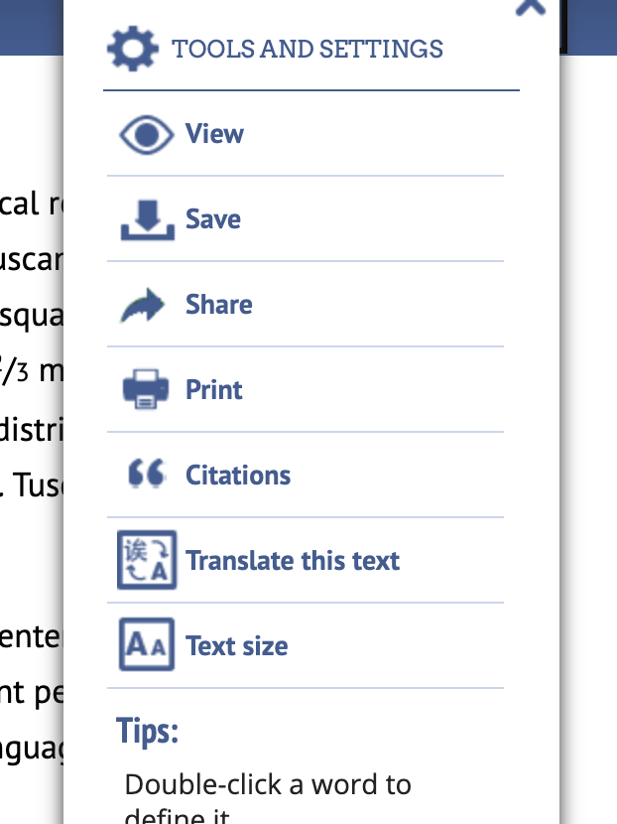
Tools to expand your reach
The Tools section of any article, activity, science project, and more offer multiple ways to share content.
Print to provide resources for students without Internet access at home. Include multiple sources in a take-home packet to work offline.
Save content to OneDrive or Google Drive for easy collaboration with colleagues.
Translate articles into over 100+ languages
Adjust settings for additional accommodation such as read aloud speed and text size.

Slide 13
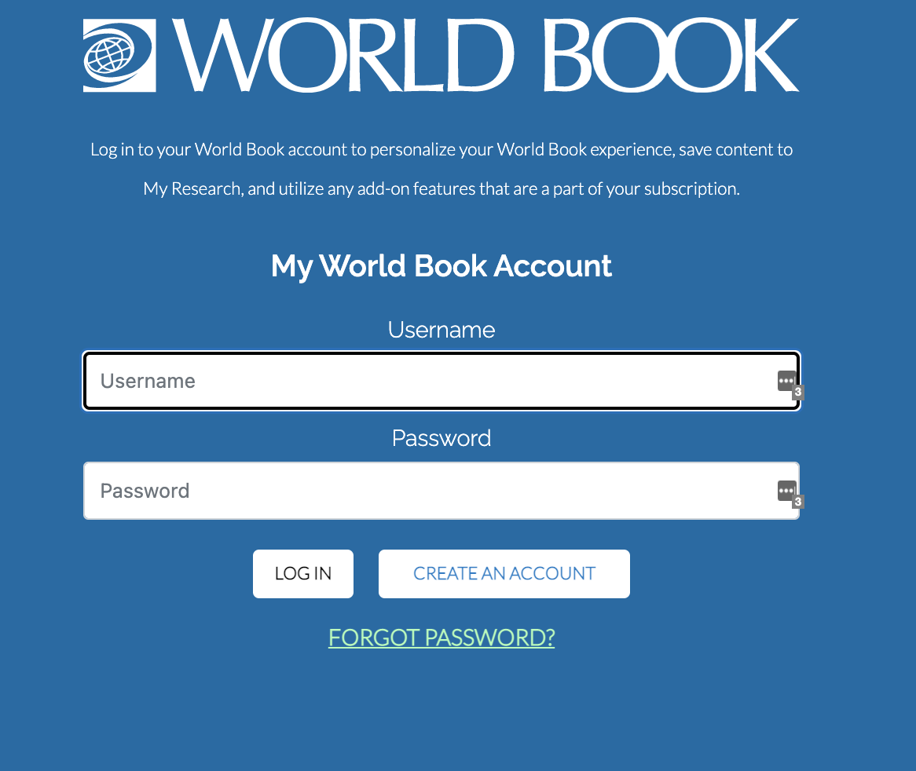
My World Book Accounts
My World Book is a way to personalize your experience by creating a My World Book Account. This is a one-time creation.
With a My World Book Account in Advanced, you can:
Create My Research projects and Pathfinders and save content to them
Save citations from the Citation Builder to your My Research projects
If World Book is integrated with your SSO (Clever, Classlink, etc) these accounts are automatically created.

Slide 14
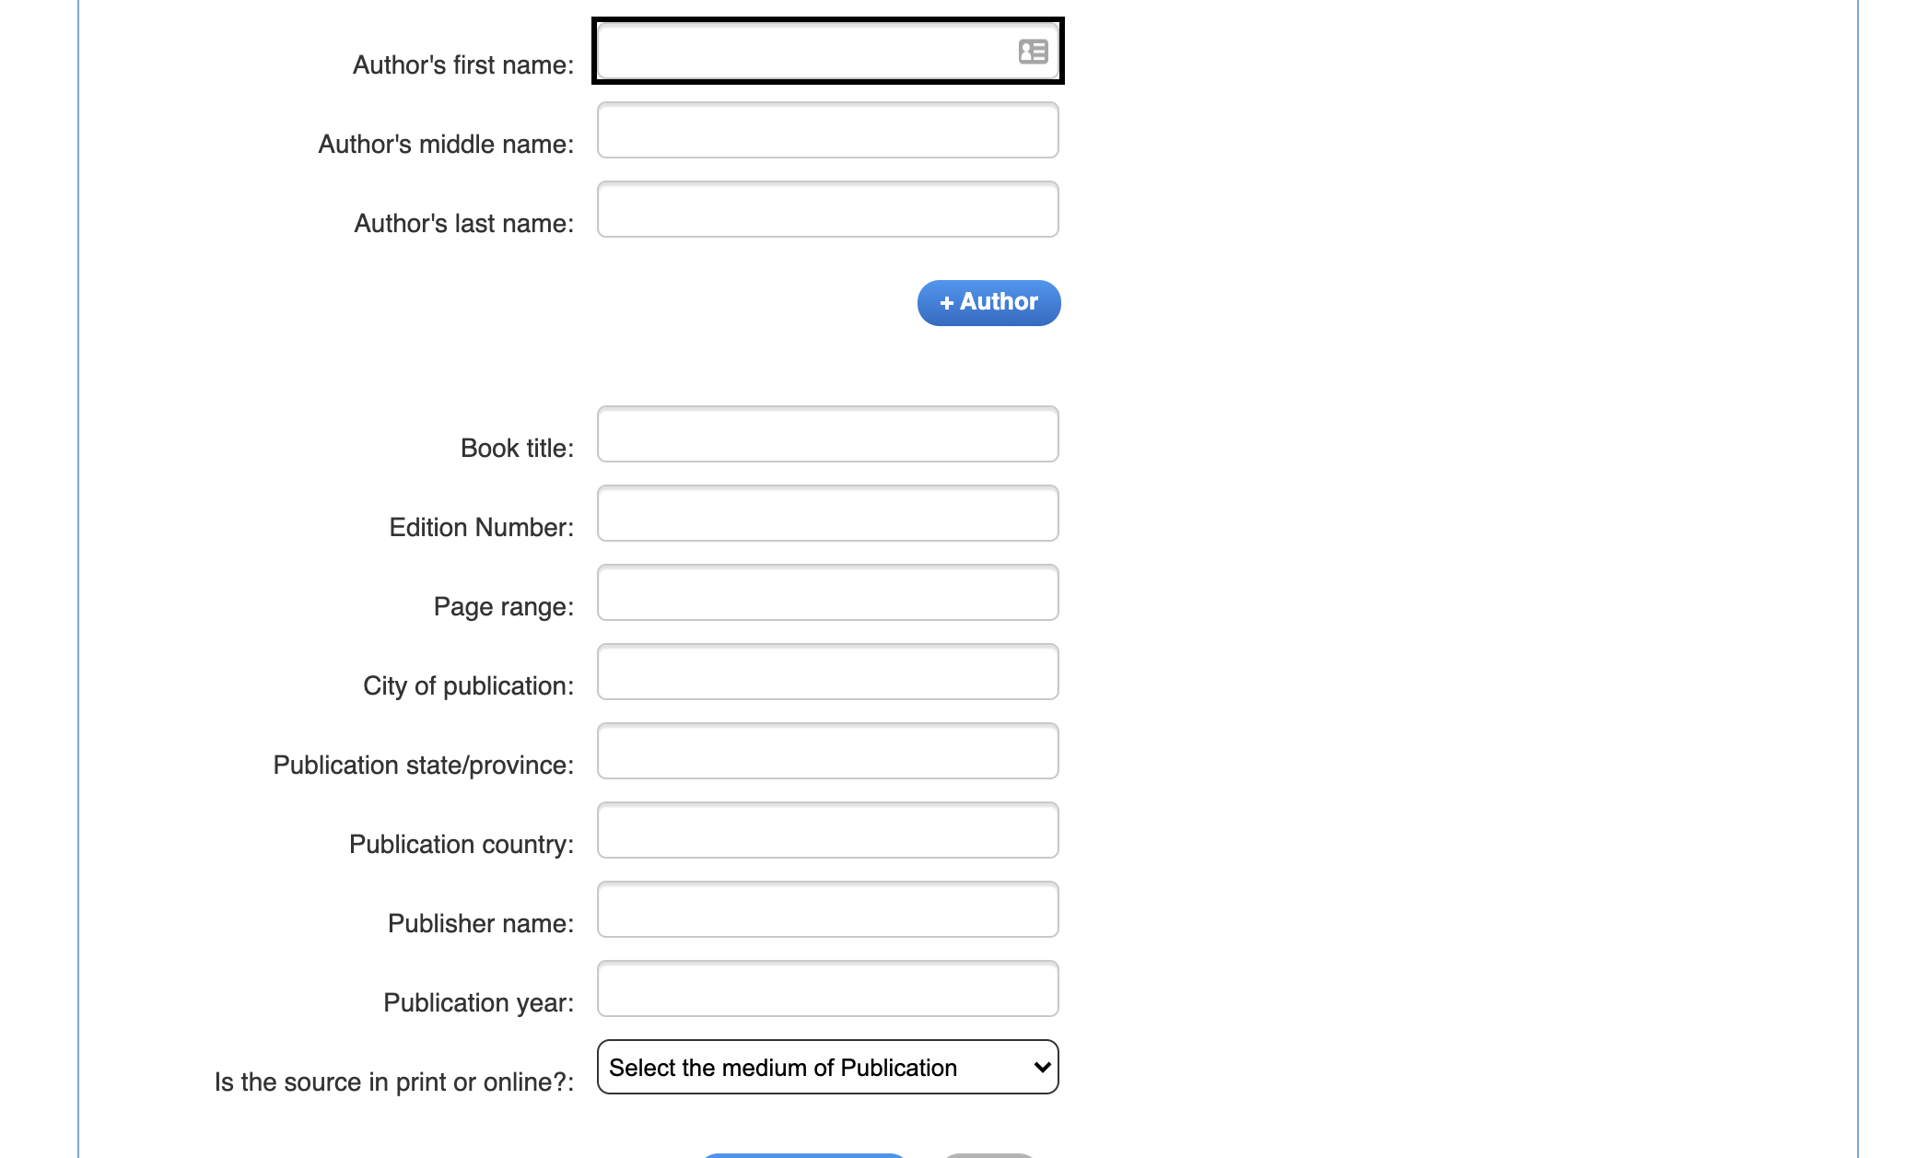
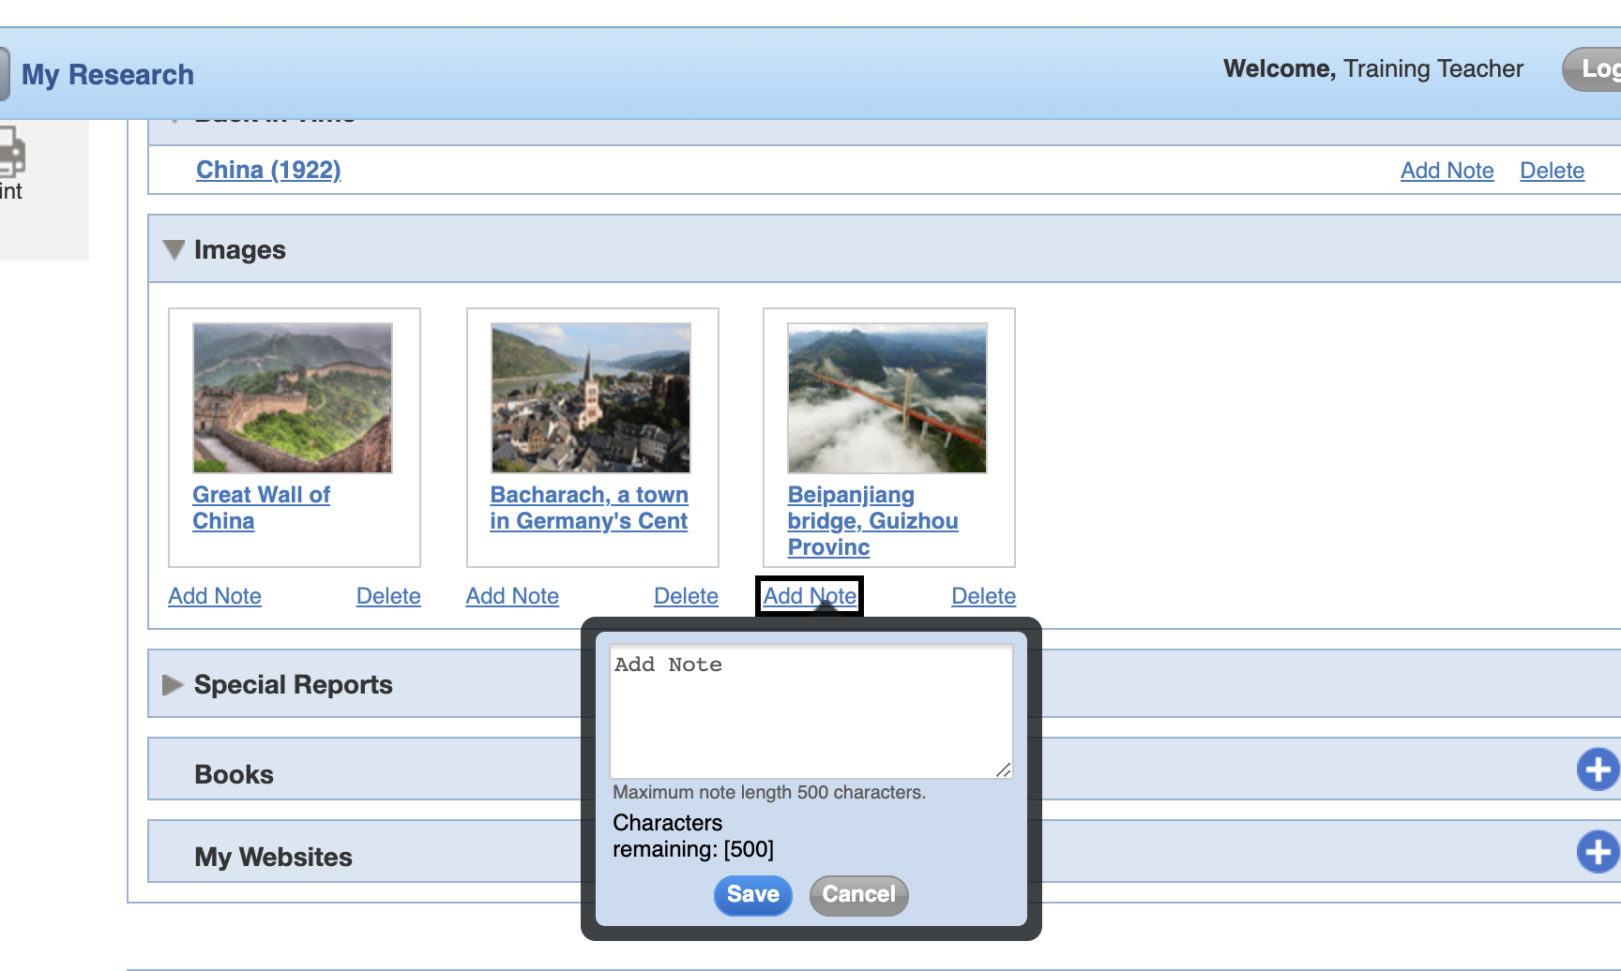
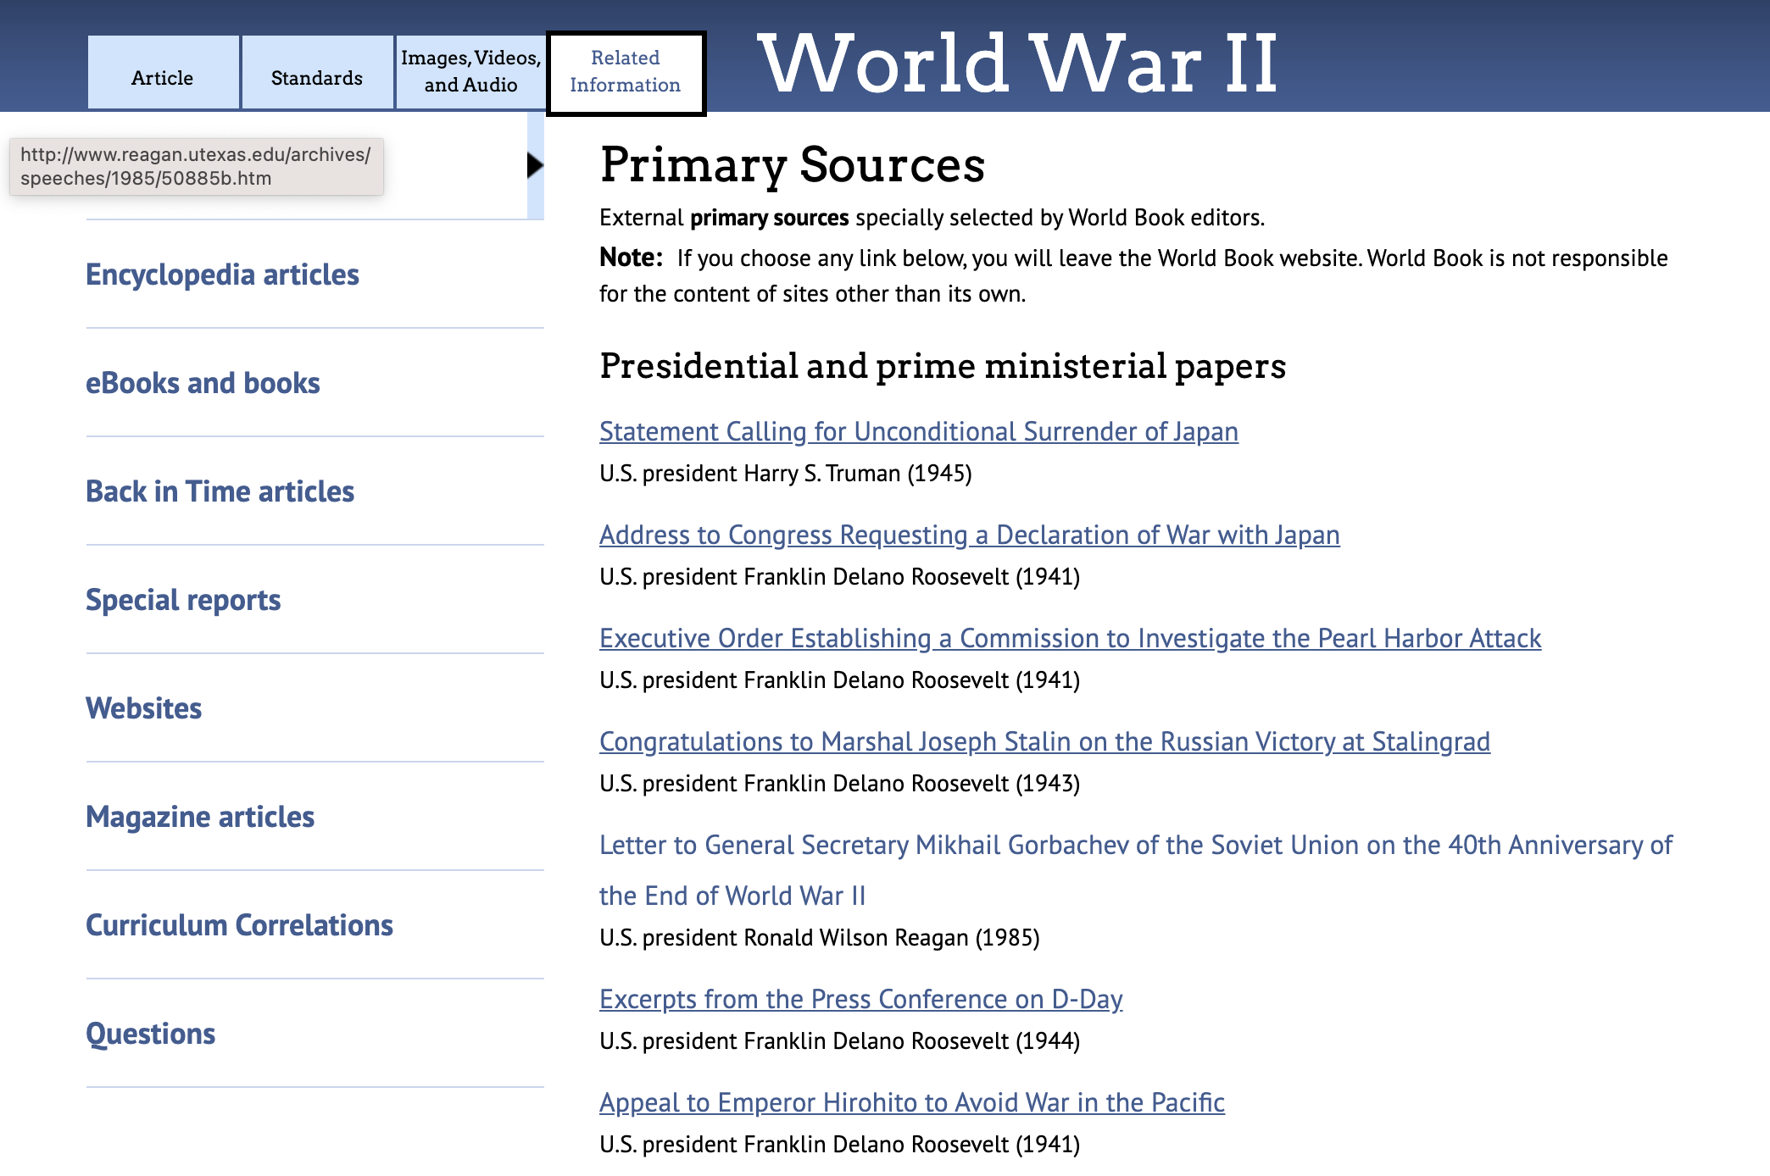
Built-in tools to aid and enhance research
An easy-to-use citation builder that formats sources in MLA, APA, and Harvard format.
The My Research feature provides a way to digitally organize and add notes to sources for projects.
Search results include primary source documents, eBook & Book recommendations, and both popular & scholarly magazine articles through our partnership with EBSCO.

Slide 15
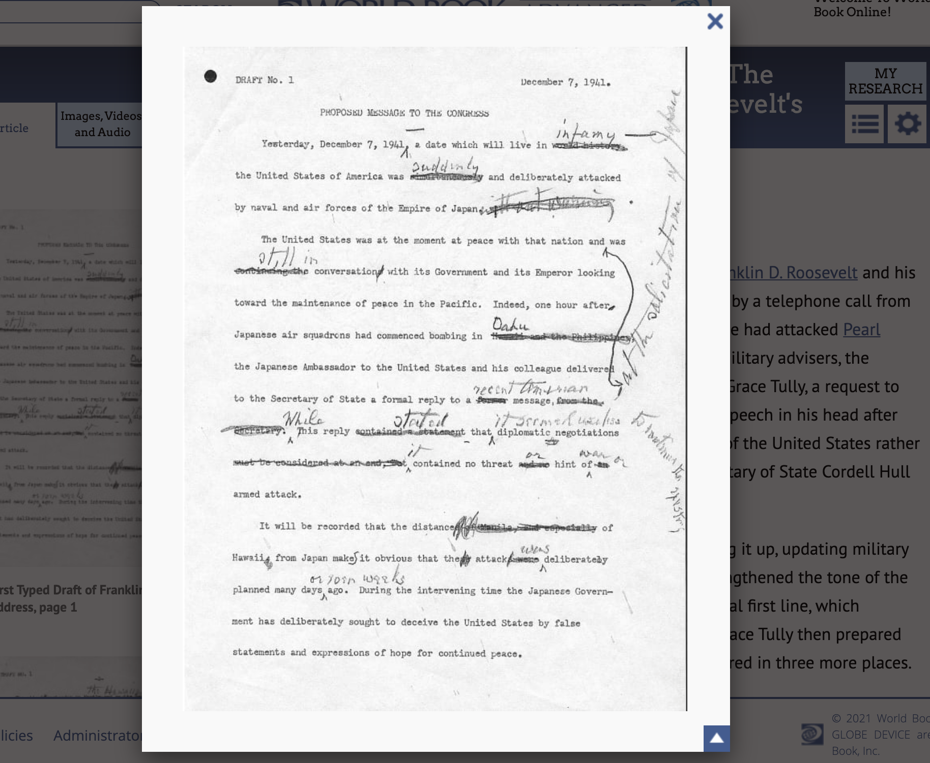
Teaching with Documents
Take primary source documents to the next level with the Teaching with Documents feature located under Educator Tools.
Each primary source begins with information to build historical context and contains discussion questions and activities to use with students.
Post the primary source to view together, print out a copy to examine at a desk, or share it on screen for virtual learning.

Slide 16
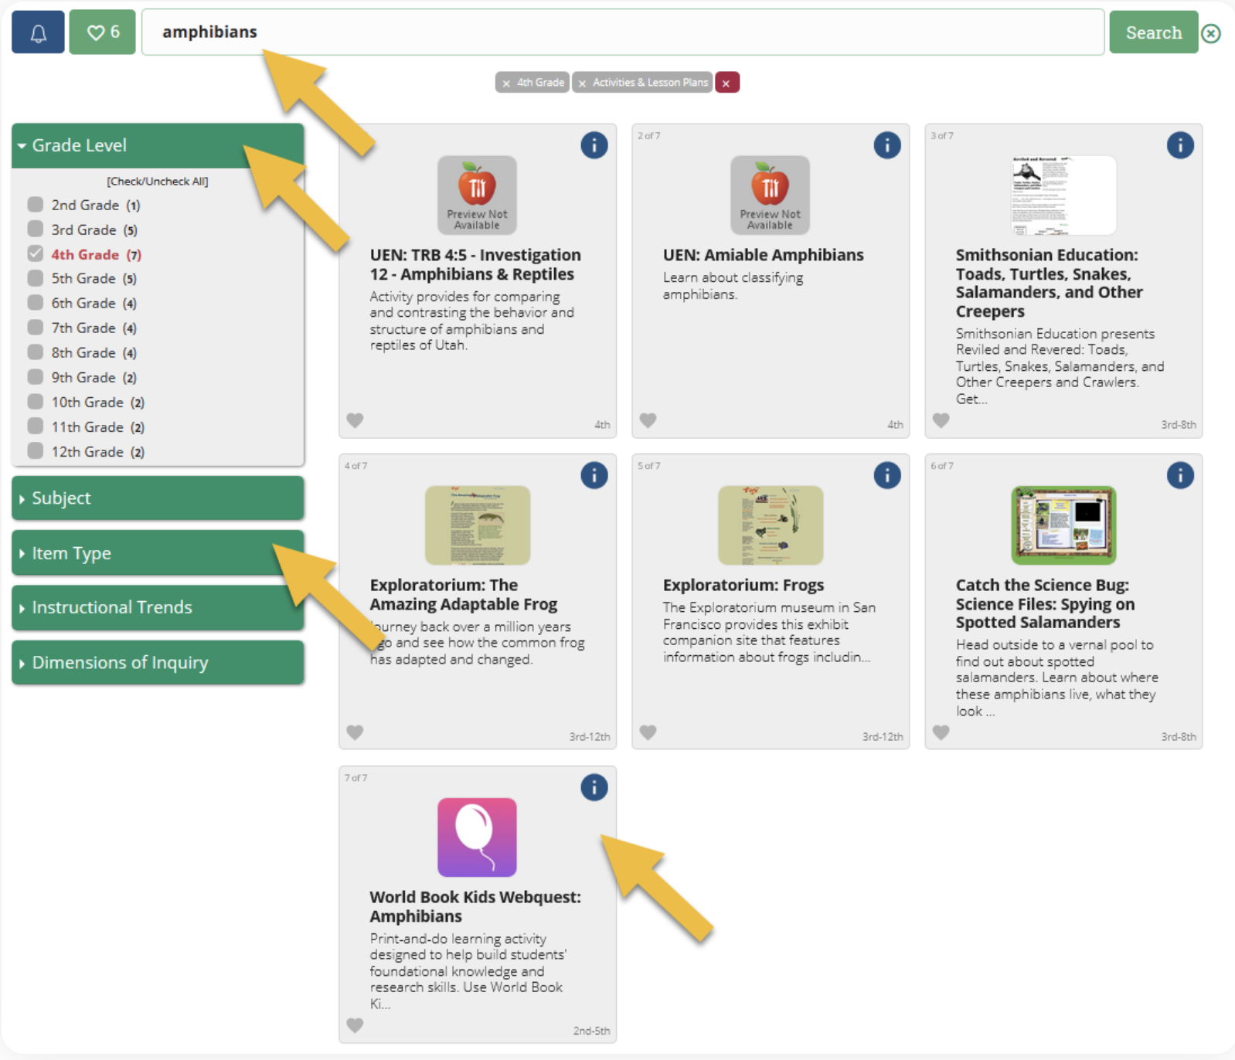
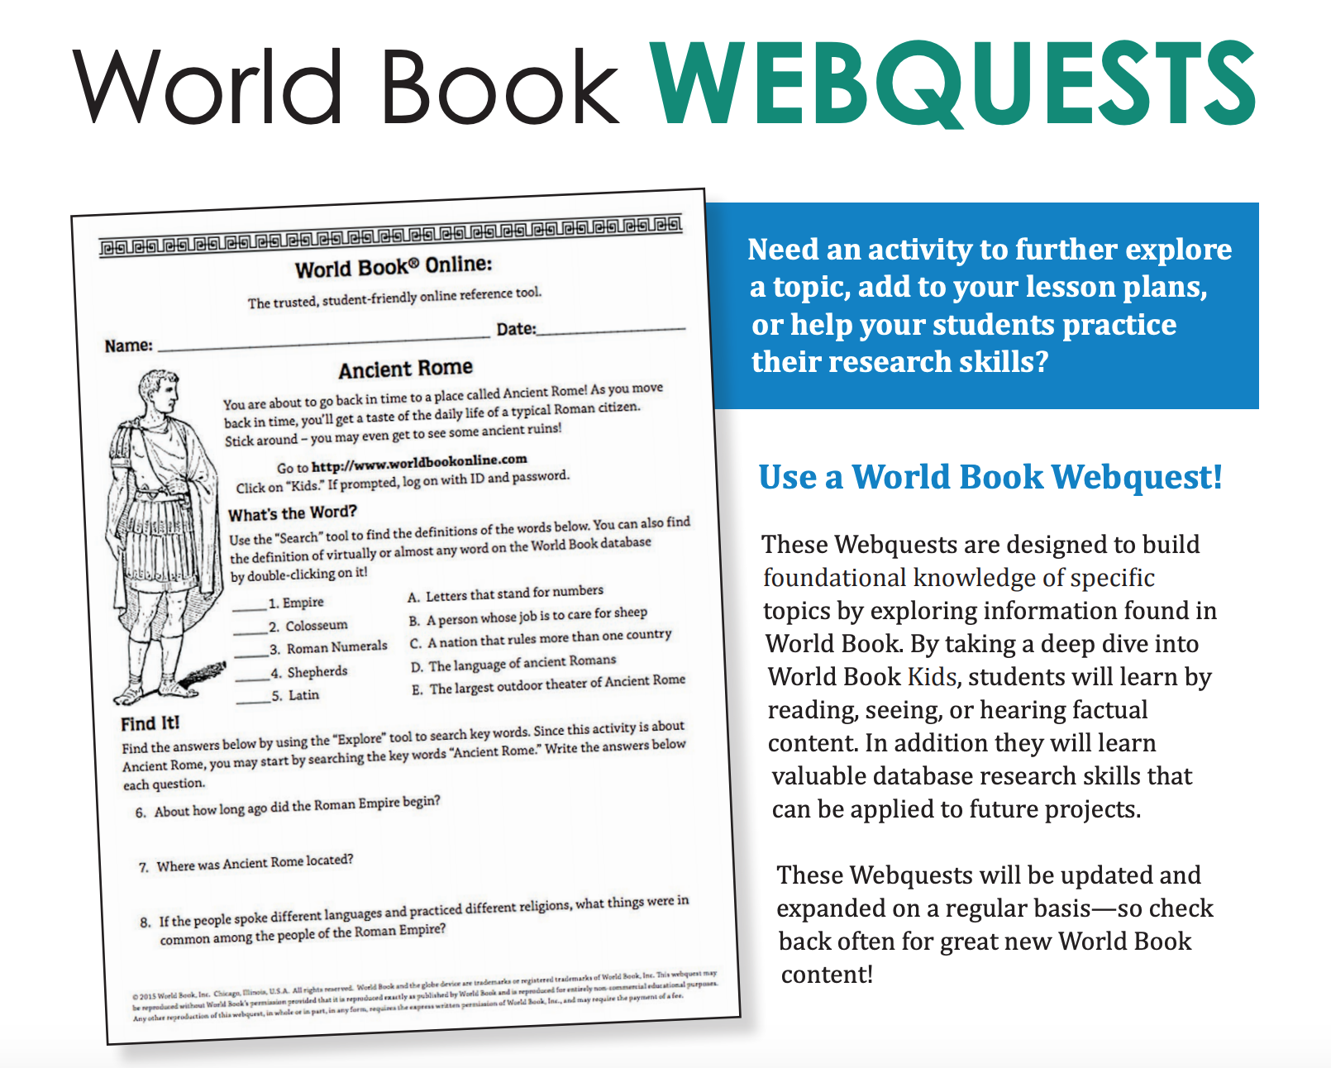
WebQuests
Organized by subject, WebQuests are great for building background knowledge before a unit, as a tool for further information and research, or as an assignment within the unit!
A variety of question types help build students’ comprehension skills and ability to look for information in multiple formats.
Have confidence that students will be successful in their quest because each one is designed to be conducted within the given World Book product.
The teacher page includes an answer key.
Use the Research Skills WebQuests to introduce students to Kids at the start of the year. This quest will lead them through the resource so they are comfortable navigating around and using this on their own!
Find WebQuests by searching in INFOhio’s Educator Tools.
Notes:
Searching for “webquest” or a specific webquest is easy when using INFOhio’s Educator Tools.

Slide 17
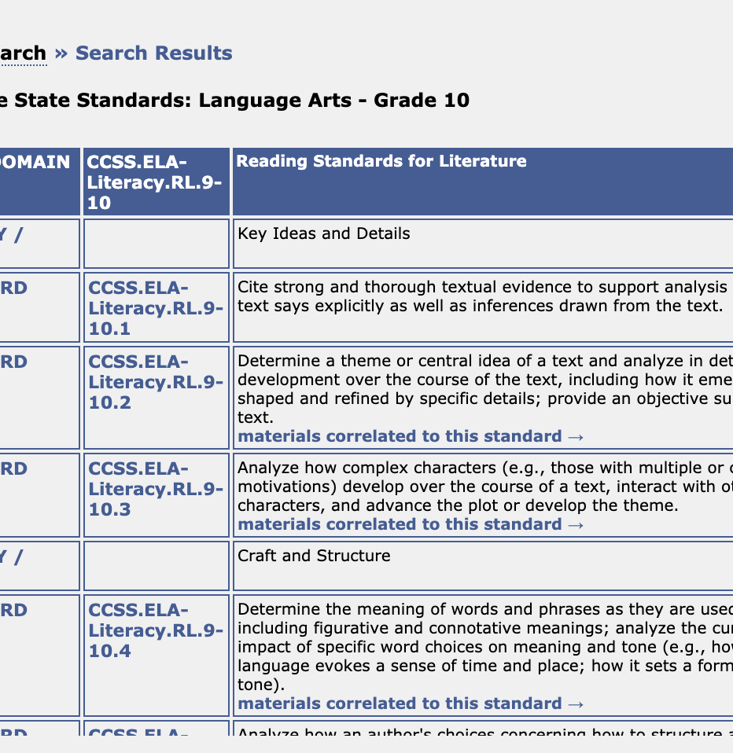
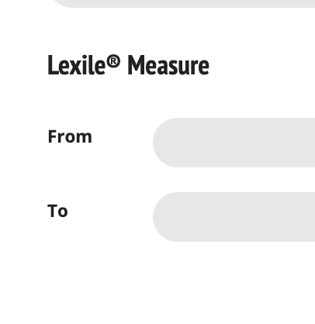
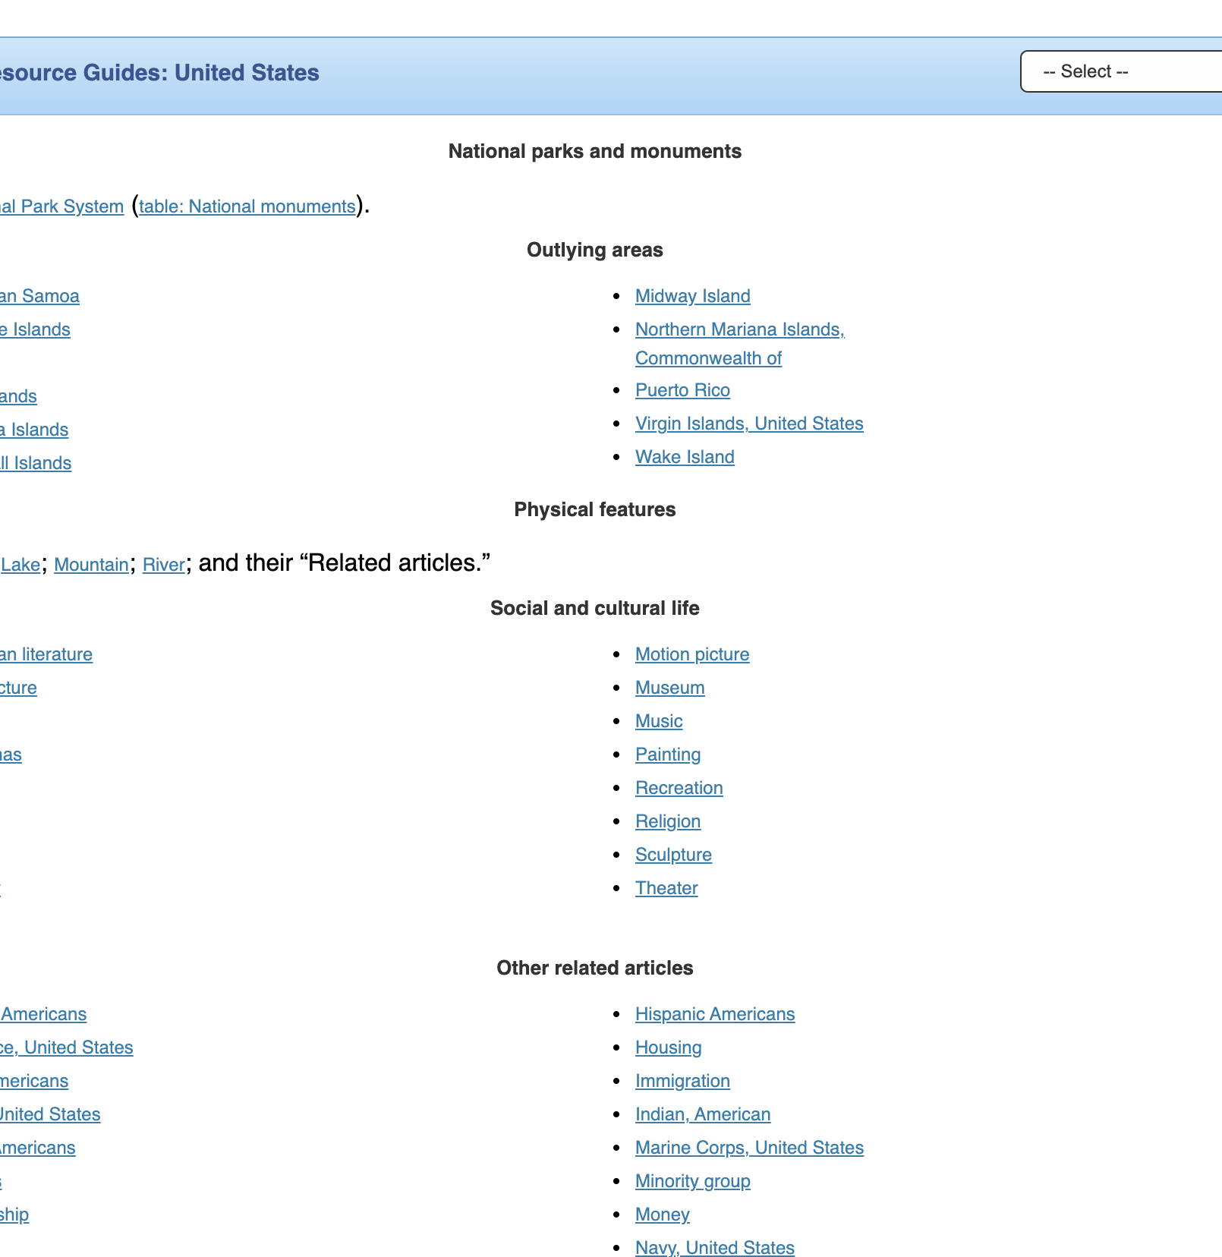
Educator Tools
Search for material by standard
Save time and look for content by learning objective. Use the curriculum correlations feature under For Educators->Educator Tools.
Lexile Level
Pull content from Advanced to work into platforms you already utilize. Any article can be shared directly with Google Classroom by going to the gear wheel and click Share to Google Classroom.
Looking for material by Lexile level? Check out Advanced Search.
Resource Guides
These guides provide in-depth information on a select topic and link to a wealth of resources within Advanced. They also offer links to curriculum and achievement standards, as well as study skills information.

Slide 18
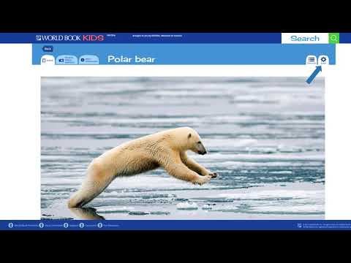
Direct Access to Articles from INFOhio’s ISearch
Notes:
Watch this video to learn how to share articles from World Book Advanced using INFOhio’s ISearch.
INFOhio’s ISearch: https://isearch.infohio.org, lets you search nearly all INFOhio resources from a single search box.
If you use a platform, other than Google Classroom, articles from World Book Advanced can also be shared with a direct permalink from ISearch that will work in any learning management system.

Slide 19
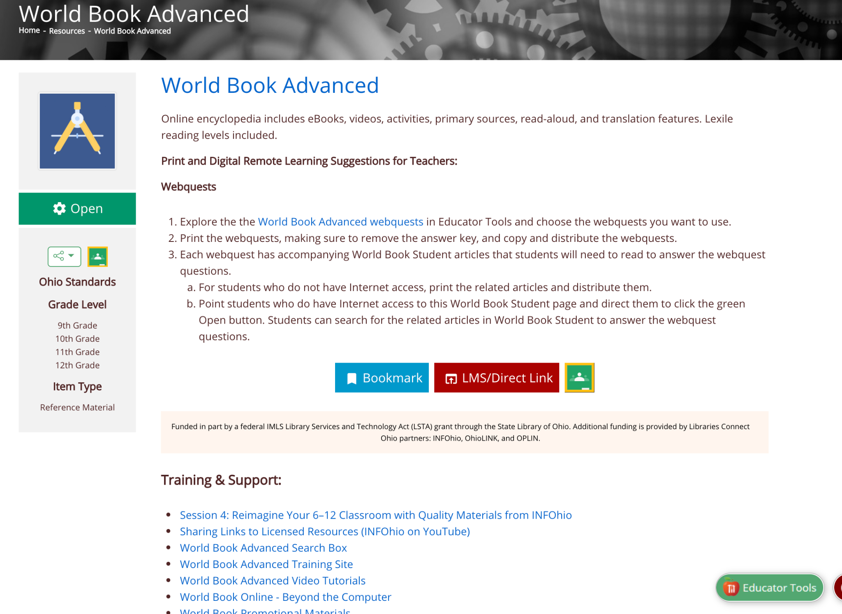
Ideas & Training

Slide 20
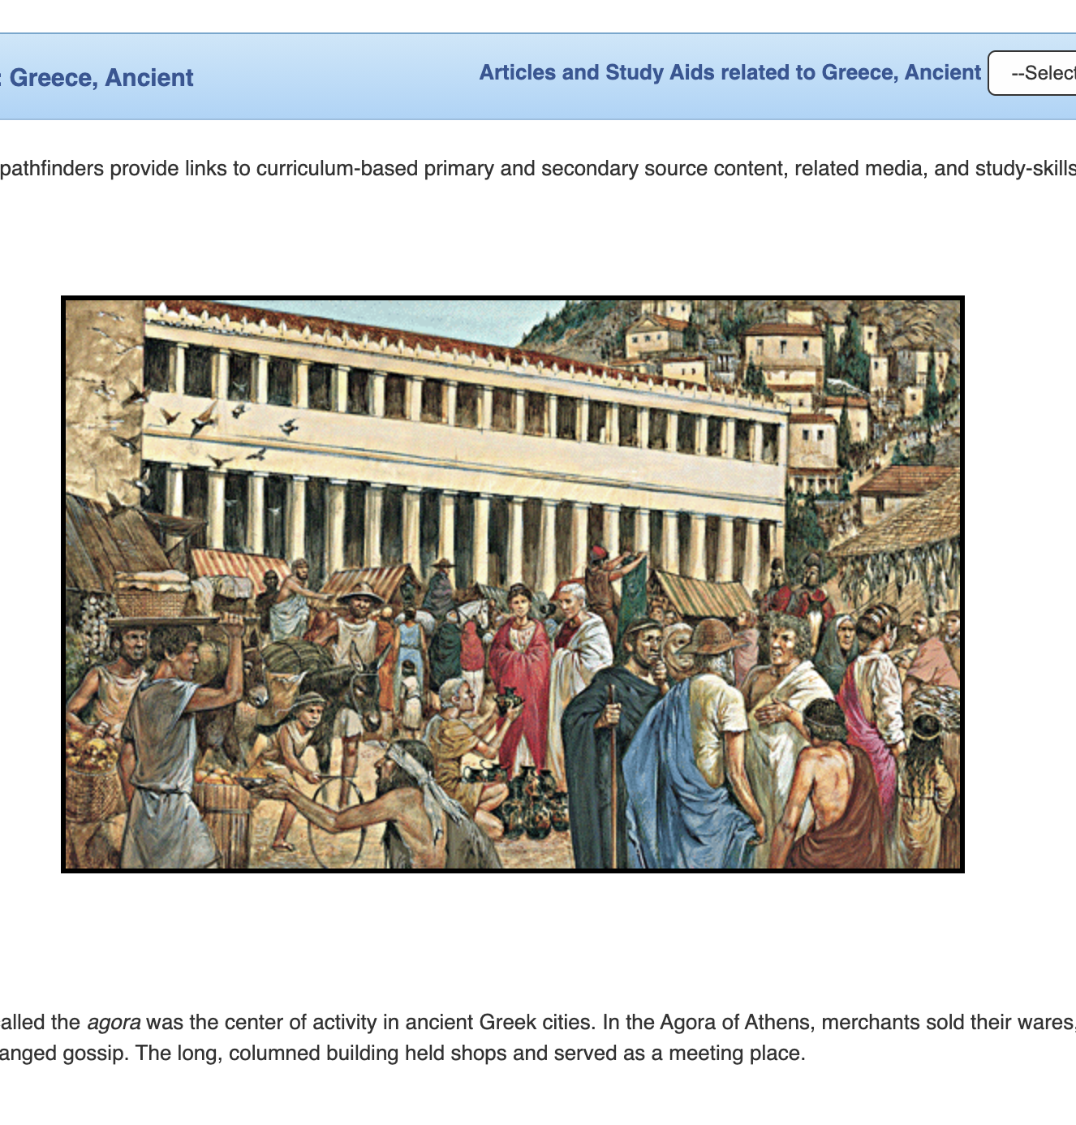
Ideas for Use in the Classroom
Build global awareness with Government Websites.
Access primary source documents.
Compare events from around the world and see the news cycle in other countries using World Newspapers.
Save time creating bibliographies with the citation builder.
Stay up to date on current events through In the Headlines.
Discuss perspective with Back in Time articles.
Guide students to content by creating a topic-specific pathfinder.
Display Today in History as a class opener.
Notes:
For more information/talking points, check here- https://infohio.org/resources/item/world-book-advanced

Slide 21
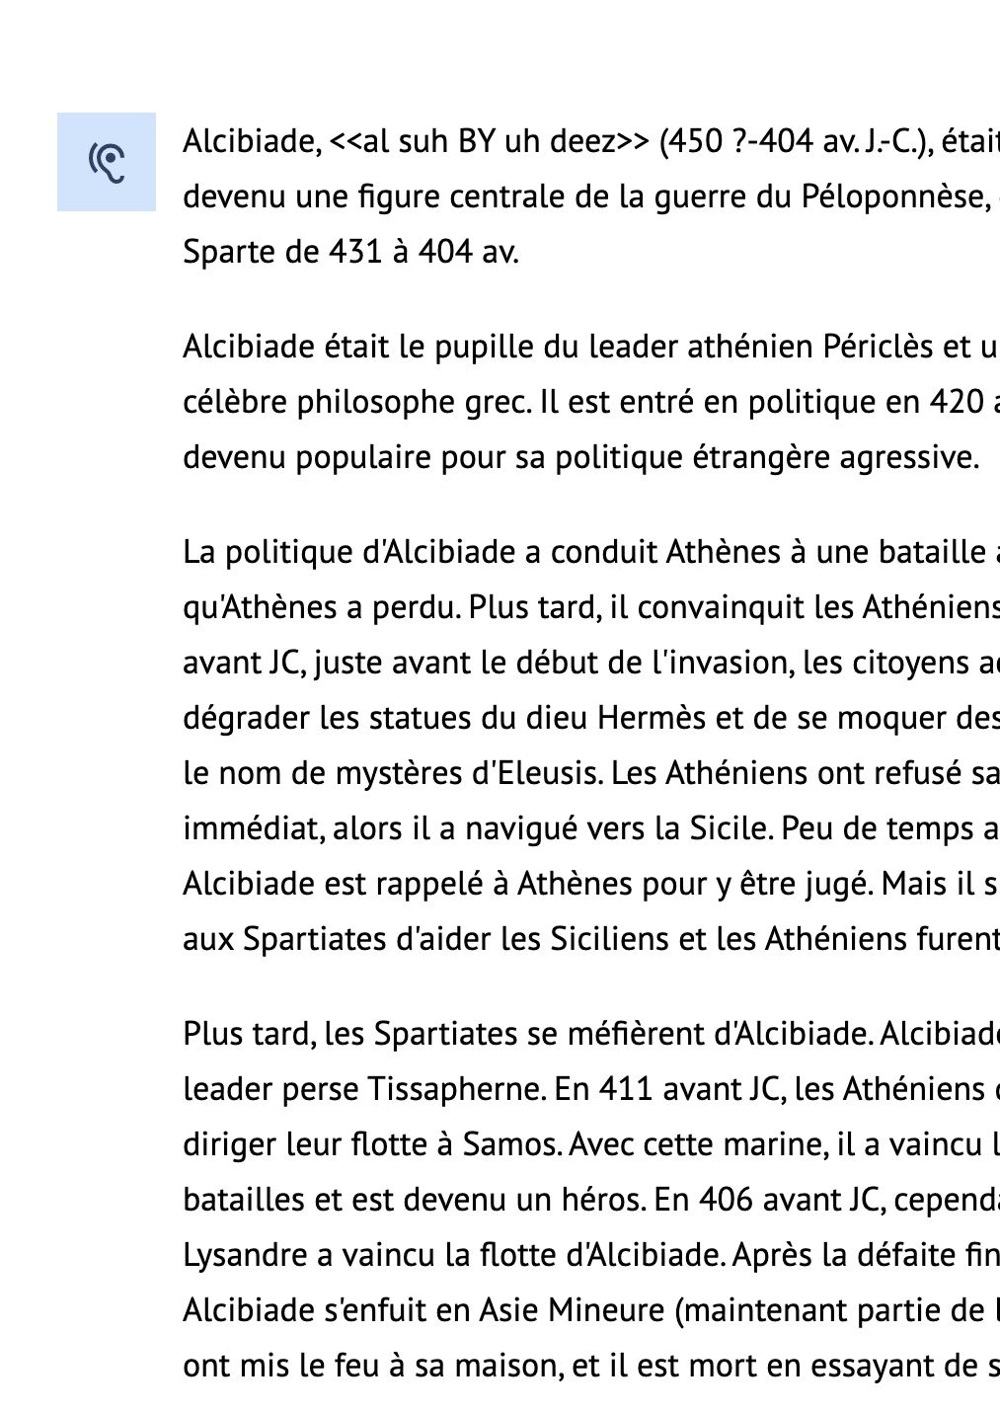
Ideas for Use in the Library
Help students and adult researchers conduct research in a safe, trusted environment
Let users know about the ad-free citation builder
Direct patrons that need resources in another language to World Newspapers and the translation tool
Help patrons get started on a topic with resource guides or pathfinders
Notes:
For more information/talking points, check here- https://infohio.org/resources/item/world-book-advanced

Slide 22
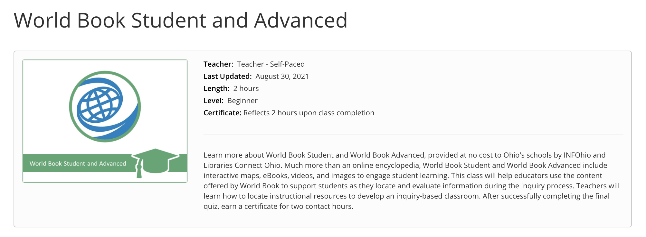
Learn More with INFOhio Classes
INFOhio Campus provides classes to help teachers integrate licensed resources into their classrooms.
Take this asynchronous, self-paced, World Book Student and Advanced Class and earn 2 contact hours after completion of the final quiz.
Notes:
https://infohio.org/campus/learning-pathways/course/world-book-student-advanced

Slide 23
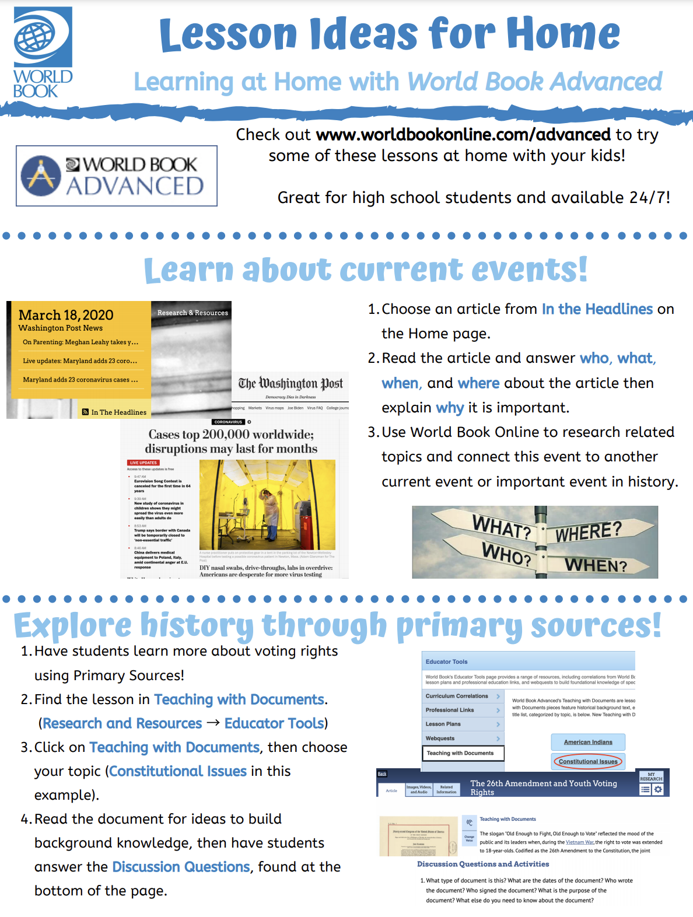
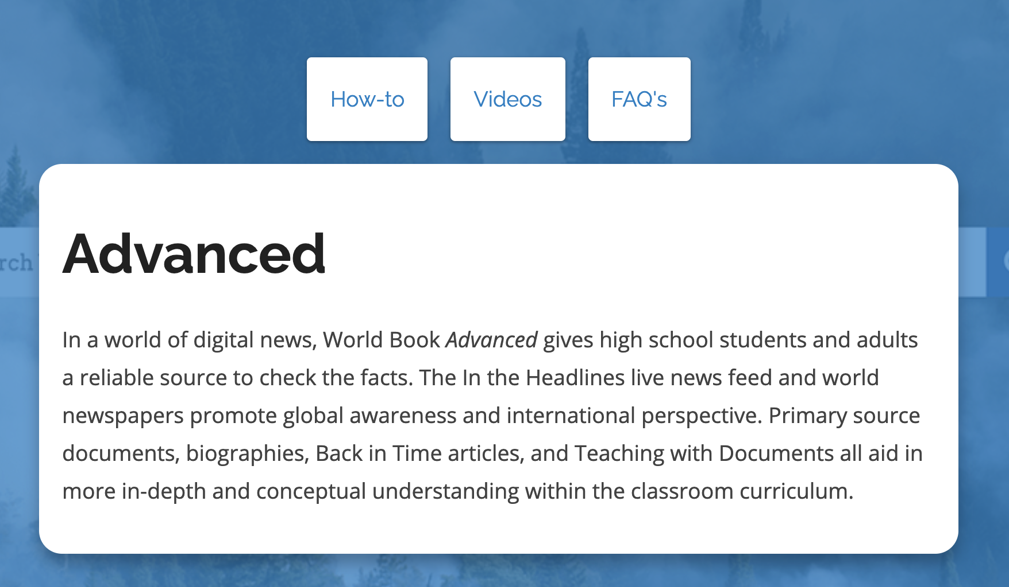

Training Material
Free promotional material such as colorful social media posts, bookmarks, flyers, and more!
How-to articles and tutorial videos on each feature of Advanced
Ideas for use in the classroom & at home
Notes:
Find training and support on the INFOhio information page: https://infohio.org/resources/item/world-book-advanced and also check here- https://www.worldbookonline.com/training/products/student/student-index.htm

Slide 24
Presented by:
Contact Me!

